Slide 1

Lab 5: 4-BIT ADDERS
CSE 2301 – Fall 2024

Slide 2
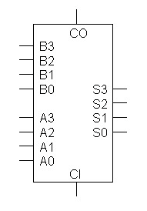
Introduction: ADD and SUBTRACT BINARY
As you know, we don’t really have “subtractors” in digital logic, and instead work by adding negative numbers, often in 2s Complement form.
To the right is a 4-bit full adder. You will find it as shown in LogicWorks.
A₃A₂A₁A₀ and B₃B₂B₁B₀ are the two 4-bit inputs
S₃S₂S₁S₀ is the 4-bit output
CI is the carry in (1 bit)
CO is the carry out/overflow (1-bit)

Slide 3
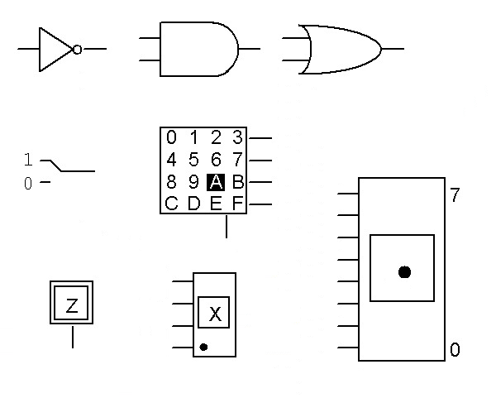
PART 1: ADD UNSIGNED NUMBERS
You will start by attempting to add together three 4-bit unsigned binary numbers (positive only). These values will be input by hex keyboards.
Display an output of up to 45. HINT: What does CO represent? HINT: Addition A + B + C = (A + B) + C
You should only need two of the aforementioned adders (plus additional logic) to complete this task.

Slide 4
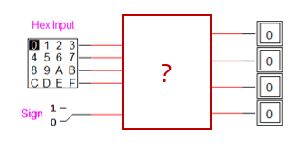
PART 2: Convert to 2’s COMPLEMENT
Before moving forward, you’re going to have to develop a circuit capable of converting an unsigned binary number to 2’s Complement based on the input of an auxiliary sign bit.
Recall that this conversion involves flipping every bit and then adding 1. How can we flip every bit, but only when the number is negative? And what about adding 1?
HINT: Think XORs and adders.

Slide 5
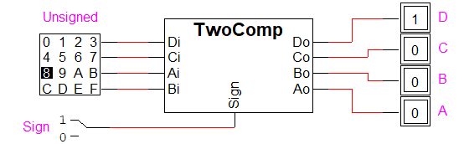
PART 2: CREATING SYMBOLS
Symbols are extremely useful when developing larger circuits in LogicWorks, or multiple circuits with similar functionalities. A symbol is effectively a discrete subcircuit, but it can do whatever you design it for. Think of it as a function used to eliminate reused code.
Once you create a working 2’s Complement circuit, we’re going to convert it into a symbol. The instructions detail this process in full.

Slide 6
PART 3: TWO’s COMPLEMENT ADDER
Using the converter that you just finished, you will now create a circuit that converts two numbers from unsigned binary into two’s complement, adds those together (using a 4-bit adder), and then provides three outputs:
The unsigned magnitude of the result (recall that converting back from 2’s Comp is the same as converting to it) as a hex display
The sign of the result as a binary probe
Whether or not overflow occurred as a binary probe
Create another symbol for the detection of overflow.

Slide 7
PART 3: TWO’s COMPLEMENT ADDER
Recall that the sign of a 2’s Complement number is indicated by the MSB (denotes the negative weight).
A 4-bit 2’s Complement number can only account for values between -8 (1000₂) and +7 (1111₂) . Anything outside this range is considered an overflow.
** Overflow is not indicated by Cout (CO) for signed values. Instead, recognize that if you add two positive numbers and get a negative as output, or two negative numbers and get a positive, you must have produced a result greater than 7 or less than -8.

Slide 8
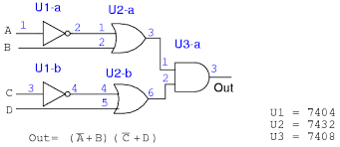
REPORT REQs: Convert to 2’s COMPLEMENT
In the report, you will be required to label your symbols (that is, the circuits that are turned into the symbols) with “reference designators”.
Label the pins according to how they would appear on a physical chip. In the image shown, U1 represents an inverter (7404). The first INV/NOT gate would have input pin 1 and output pin 2 on a 7404. The second gate takes pins 3 and 4.
Be careful! U2-c would be 9, 8 → 7!

Slide 9

Other notes AND report information
Remember to make your circuits tidy and clear. It may help to use integrated circuits in you LogicWorks design to assist with labelling. For example, instead of having individual AND gates, you could place a 74_08 component, which has 4 ANDs.
This lab assignment is due next Thursday/Friday, as usual.

